Slide 1
How to integrate Shopify?
Client Integration

Slide 2

Congratulations on the decision to integrate your Shopify webshop with cargo-partner Nippon Express.
Your benefits:
Global network and proven expertise
Competent advice from logistics/last-mile experts
Transport solutions by AIR, SEA, RAIL, ROAD
Dedicated customs department
Experience in cross-border e-commerce

Slide 3
Please follow the following simple steps to integrate your Shopify webshop with cargo-partner Nippon Express.
This tutorial covers:
How to synchronize your Shopify Products with cargo-partner’s NX system?
How to synchronize your eFulfillment’s warehouse stock to your Shopify store?
How to forward your Shopify orders to cargo-partner Nippon Express
How to receive a dispatch confirmation with tracking ID in Shopify when your customer’s order leaves the warehouse?

Slide 4

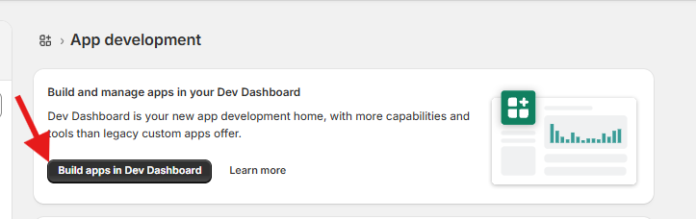
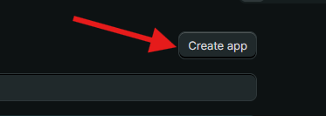
To synchronize data with cargo-partner NX, you have to create a custom Shopify App. Here's how you can set it up.
Step 1: Create your own Shopify App.
Log into your Shopify store
Click on Apps
Click on “Develop apps”.
Click on “Build apps in
Dev Dashboard”.
Click on “Create app”.

Slide 5
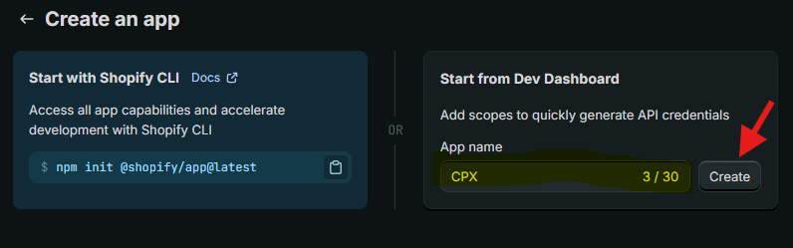
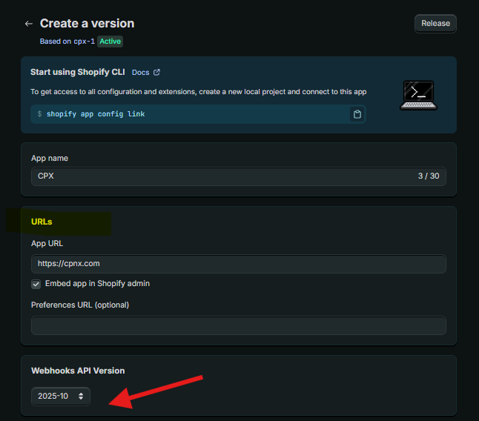
To enable all data transfer necessary for the integration you need to configure the custom app. Follow the steps below.
Step 1: Create your own Shopify App.
Provide an App name and click “Create”
Provide:
an App URL of your choice
select Webhook API Version as below (2025-10)

Slide 6
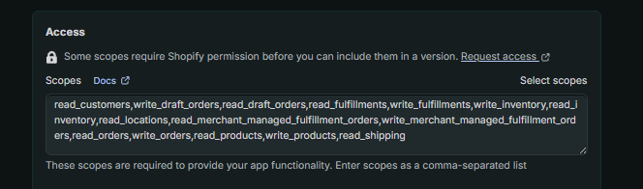

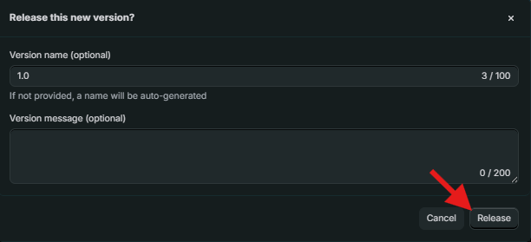
To enable all data transfer necessary for the integration you need to configure the custom app. Follow the steps below.
Step 1: Create your own Shopify App.
Set the App access scope as below
Click the “Release” button
read_customers
write_fulfillments
read_fulfillments
read_inventory
write_inventory
read_locations
read_merchant_managed_fulfillment_orders
write_merchant_managed_fulfillment_orders
write_draft_orders
read_draft_orders
write_products
read_products
read_shipping
read_orders
write_orders
Provide a version name of your choice and message (optional) and click again “Release”

Slide 7
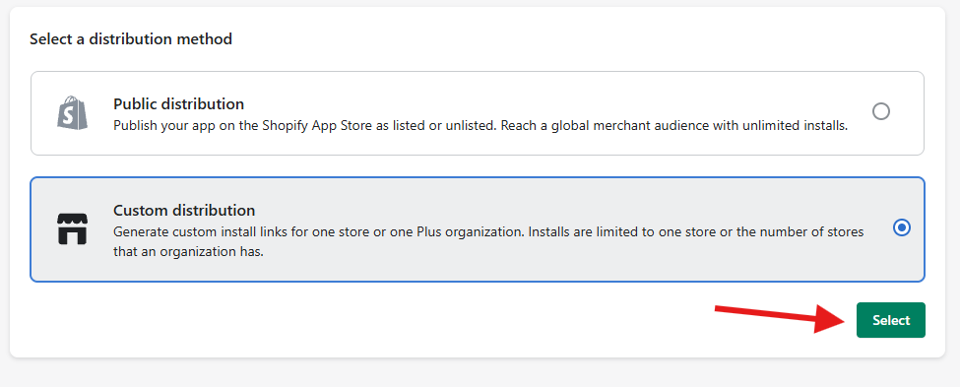
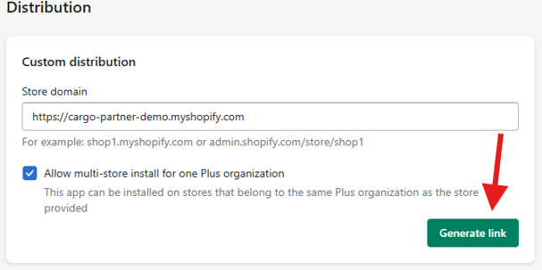
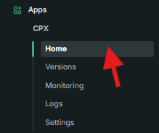
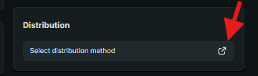
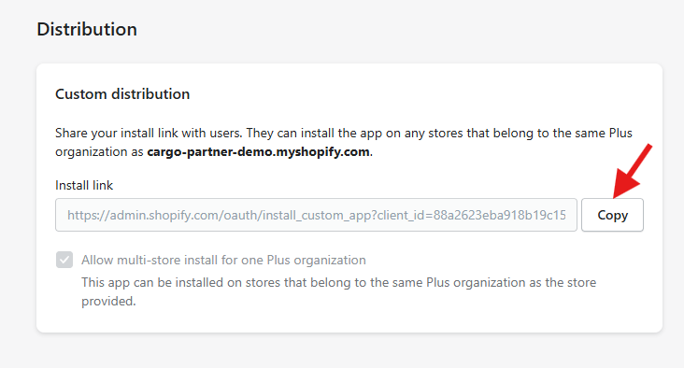
To enable all data transfer necessary for the integration you need to configure the custom app. Follow the steps below.
Step 2: Distribute & Install the Shopify App.
Go to “Apps” and click on “Home”
On Distribution panel, click the icon as below
Select “Custom distribution”, provide your store domain and “Generate link”
Copy the Install link

Slide 8
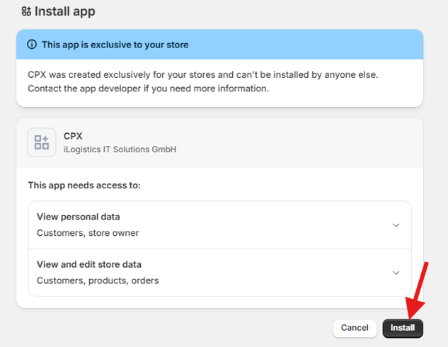
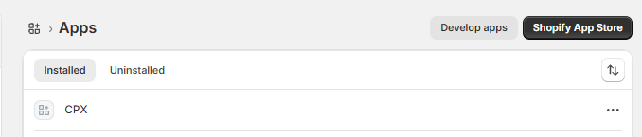
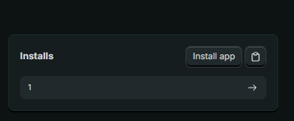
To enable all data transfer necessary for the integration you need to configure the custom app. Follow the steps below.
Step 2: Distribute & Install the Shopify App.
Open a new browser tab and paste the install link – you will be redirected to the Shopify backend app page. Click “Install”
The app is installed successfully if you can see it in the Shopify backend, under the “Installed” section
Also, in the Shopify Dev Dashboard the number of installs will show “1”.

Slide 9
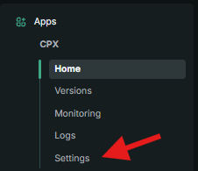
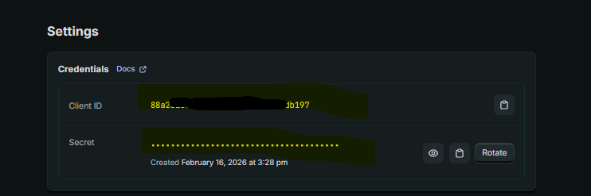
Last but not least, we need your credentials to connect us to your store. Send them to us securely.
Step 3: Collect API Credentials.
Go to “Apps” and click on “Settings”
Collect the credentials shown below
Share the Client ID and Secret with CP NX

Slide 10
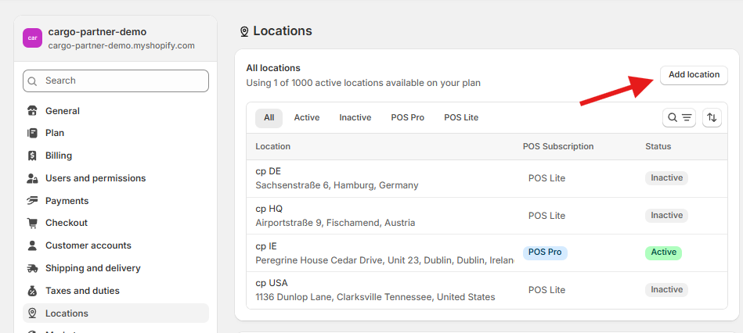
To sync inventory, you need to define a cargo-partner NX location in your Shopify store. Follow the steps below.
Step 4: Configure Location.
Add a new location from “Settings”, “Locations”. Chose a name and address that reflects your NX cargo-partner physical warehouse.
If you want to synchronize data from multiple Shopify locations per shop, please inform us!

Slide 11
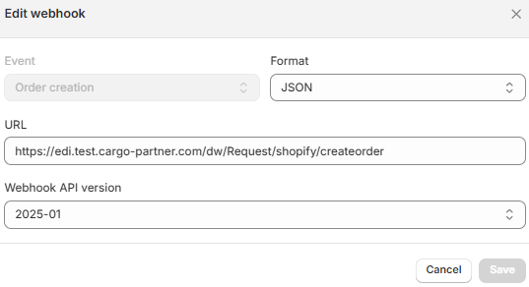
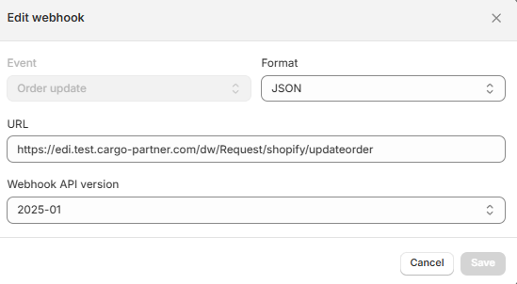
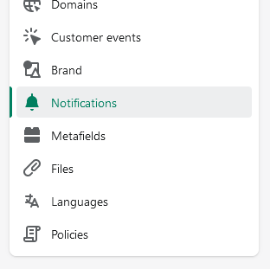
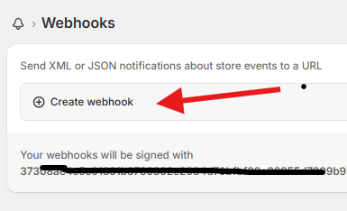

In order to push orders to cargo-partner Nippon Express WMS you need to set up webhooks in Shopify.
Step 5: Configure Webhooks.
Go to “Settings”, “Notifications”. Click on “Create webhook”.
Add two webhooks, for Order creation and Order update as shown below. Click Save.
Share the webhook key with CP NX

Slide 12
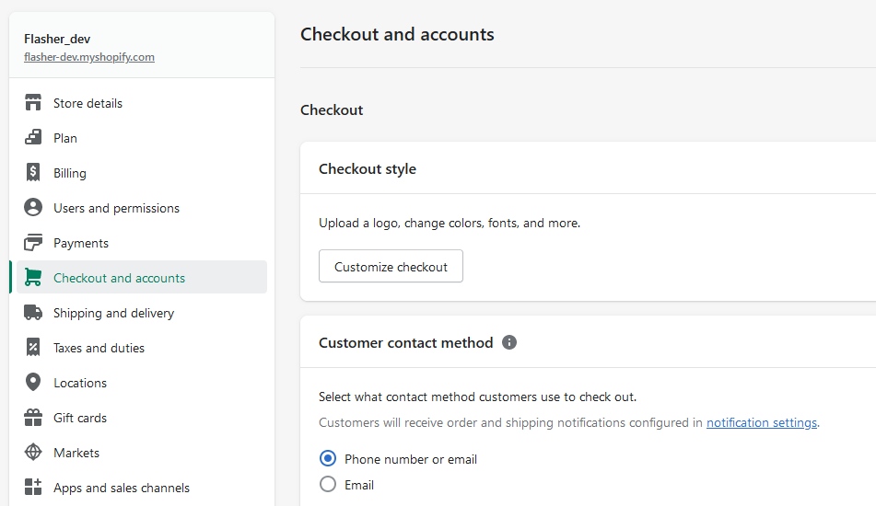
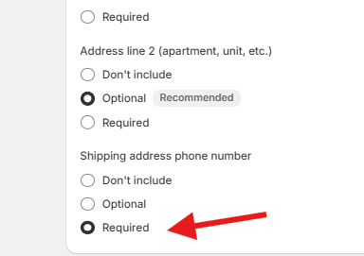
In order to process parcel orders, setup phone number. Here is how.
Step 6: Setup customer contact method.
Go to “Settings”, “Checkout” and set customer contact method to phone number or e-mail
In the same menu, find the “Shipping address phone number” section and check “Required” option
The shipping address phone number is necessary for our carriers.

Slide 13
Last but not least, we need your credentials to connect us to your store. Send them to us securely.
Step 7: Share your shop coordinates
In order to finish the connection, please share the following information with us :
Webshop URL
Client ID
Secret
Webhook key
You are ready. We will now integrate your shop.

Slide 14

Contact
Anca-Rodica Venter
Client Integration Manager
T +43 (59) 88811467
M +43 (664) 9638014
E anca-rodica.venter@cargo-partner.com
Cargo-Partner Holdings GmbH
www.cargo-partner.com

